Slide 1
JOURNEY PRESENTATION
AKSHAY P

Slide 2
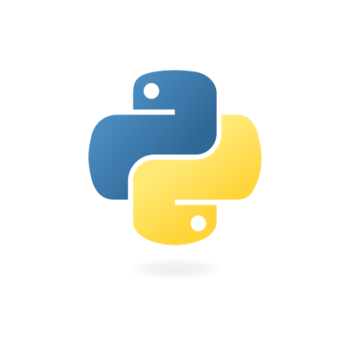

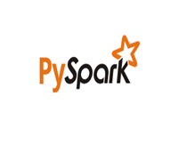
Agenda

Slide 3
Python
Python is a high-level programming language known for its readability and user-friendly syntax. It features a dynamic type system, which means you don't need to specify data types when declaring variables.

Slide 4
Basics
Readability
Cross-Platform
High level lang
Python has an easy-to-read syntax, making it easy to write and understand code. Its use of keywords and indentation helps maintain code structure.
Python is cross-platform, allowing code to run on various operating systems without modification.
Python is a high-level programming language, which means that it abstracts low-level details, making coding easier for developers.

Slide 5
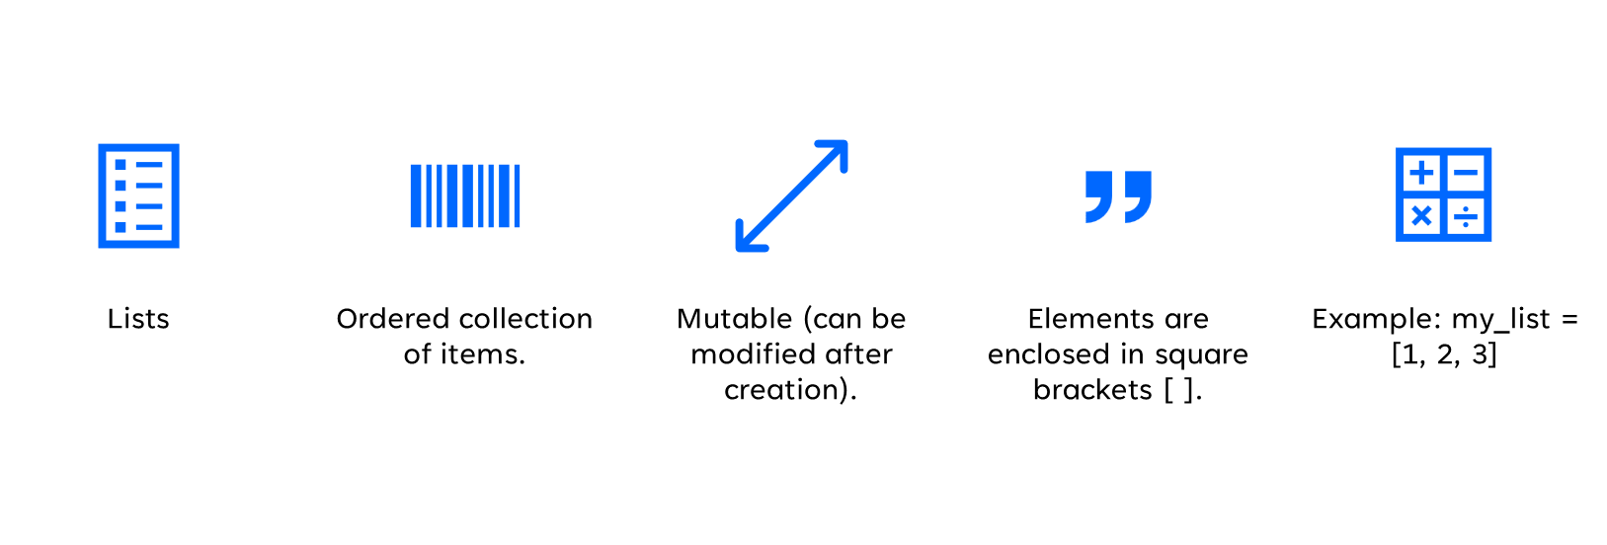
Data Structures in Python

Slide 6
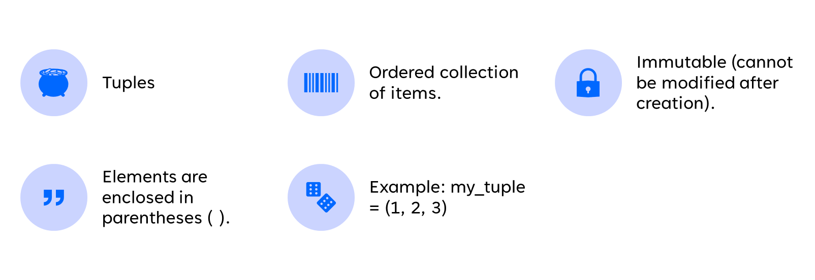

Slide 7
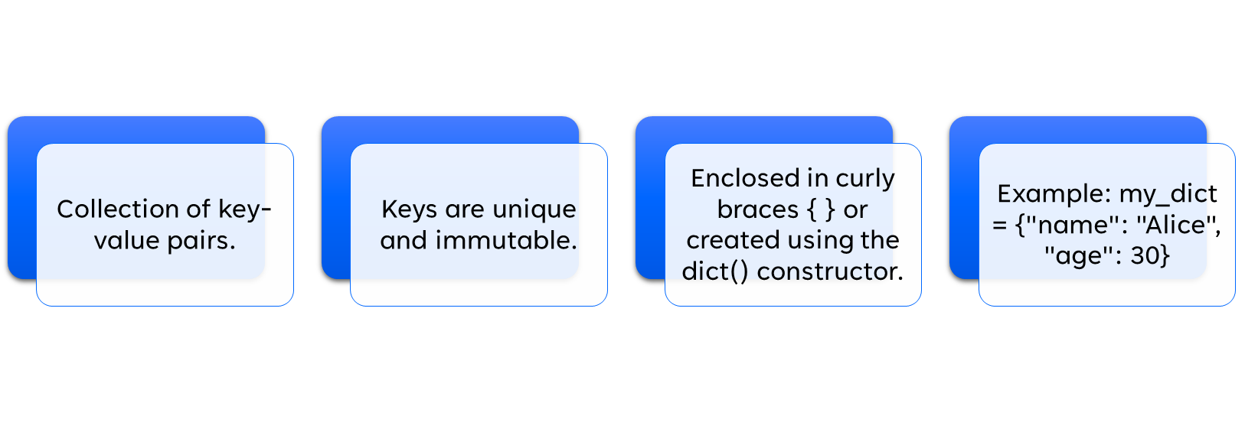

Slide 8
PySpark
PySpark is a powerful open-source framework for distributed data processing and analysis, particularly well-suited for big data applications.

Slide 9
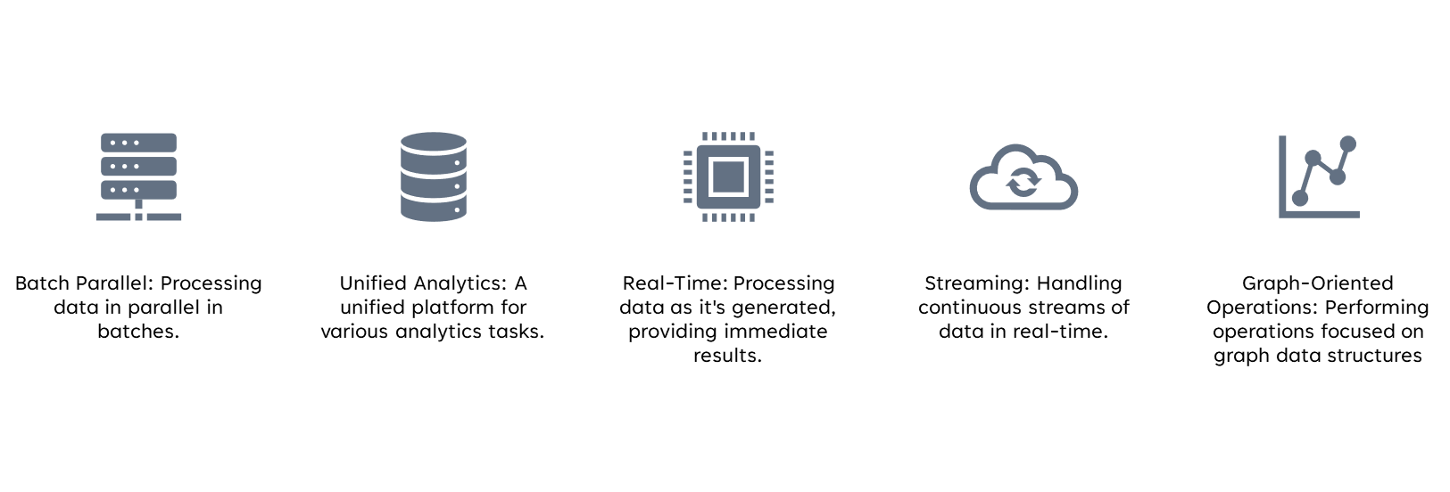
WHY to use PYspark

Slide 10
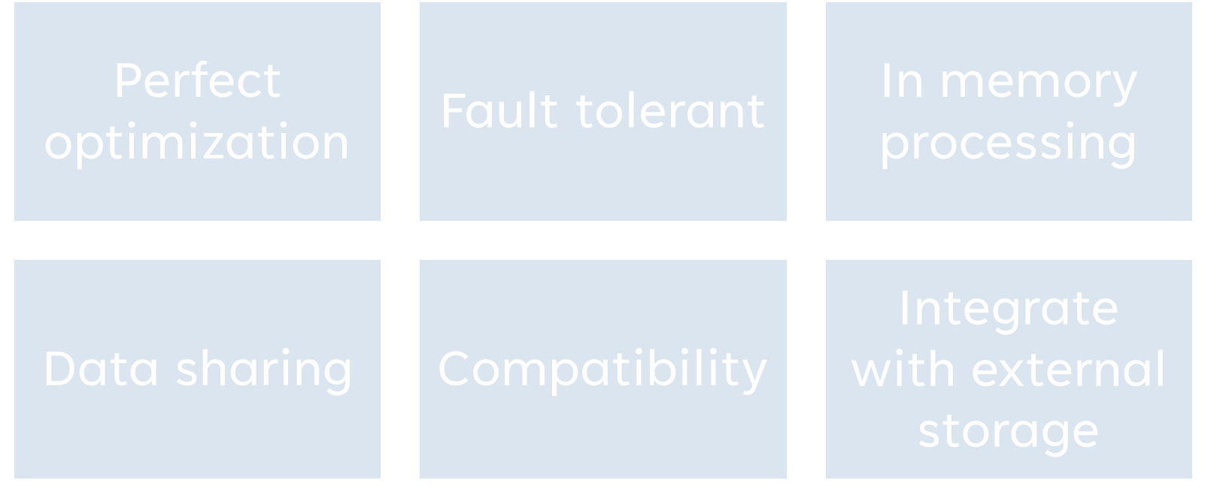
RDD (Resilient distributed dataset)

Slide 11
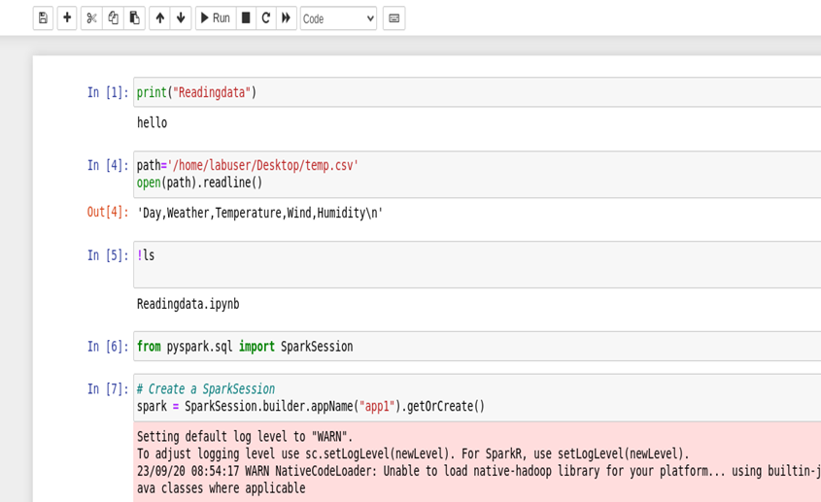
Hands-On

Slide 12
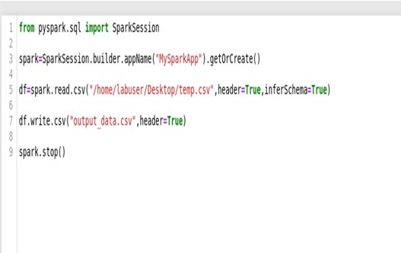

Slide 13
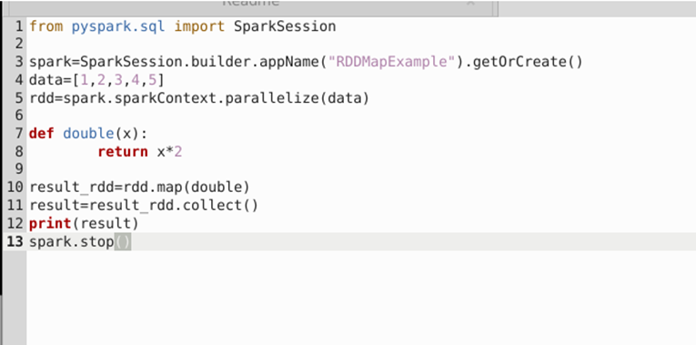

Slide 14
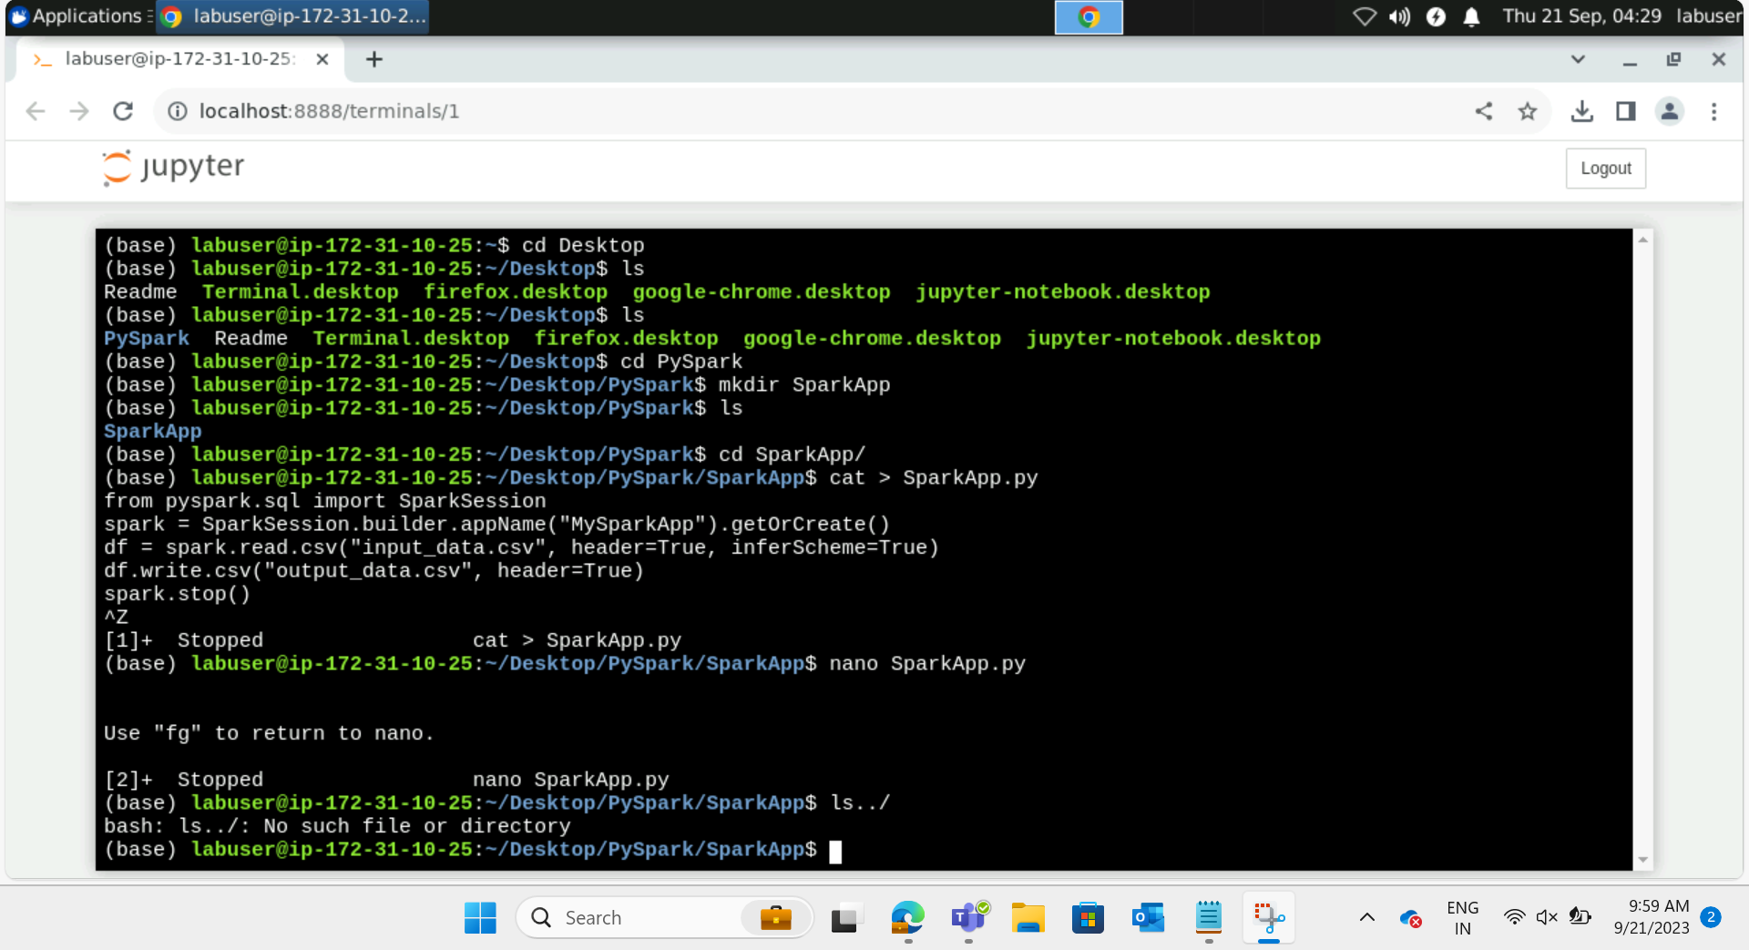

Slide 15
